Slide 1
TELECOM CUSTOMER CHURN PREDICTION ANALYSIS
A machine learning pipeline for subscriber retention strategies
TURYA JOHN STEVEN
2023-B071-21285
12th DECEMBER 2025

Slide 2
Project overview
Problem statement.
  A major East African telecom is experiencing rising churn rates among prepaid subscribers.
  Retaining existing customers is more cost-effective than acquiring new ones.
Objective.
  Develop a machine learning pipeline to predict customer churn.
  Identify key factors driving customer attrition.
  Create an interactive dashboard to visualize high-risk segments.
Dataset.
  Source: Telco Customer Churn (Kaggle).
  Features: Demographics, services, account information.

Slide 3
Data preprocessing
Methodology.
  Data cleaning: Handled missing values in the TotalCharges column (converted to numeric).
  Encoding: Applied One-Hot Encoding to categorical variables (e.g., Payment Method, Internet Service) to make them machine-readable.
  Scaling: Standardized numerical features (tenure, MonthlyCharges) using StandardScaler.
  Target: Converted Churn to binary (1 = Churn, 0 = No Churn).
  NB: Churn refers to the rate at which customers stop using the product or service over a given period of time.

Slide 4
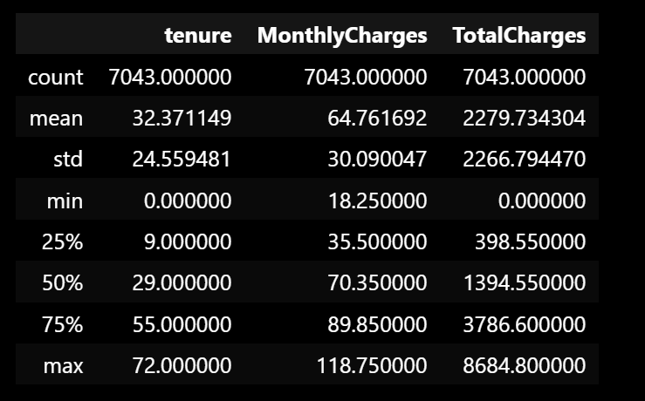
Summary statistics for numerical features

Slide 5
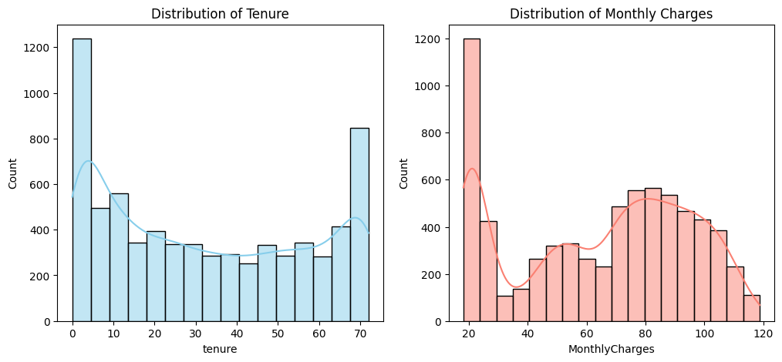
Exploratory Data Analysis (Distributions)

Slide 6
EDA - Churn Drivers
Contract Influence.
  Customers on month-to-month contracts have a significantly higher churn rate compared to one-year or two-year contracts.
Correlations.
  Negative correlation between tenure and Churn (Longer stay = Lower risk).
  Positive correlation between monthlyCharges and Churn (Higher bills = Higher risk).

Slide 7
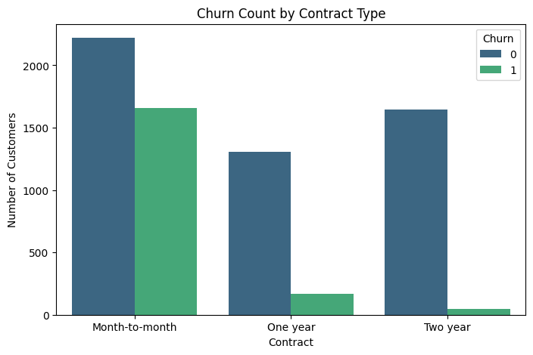
Churn count by contract type

Slide 8
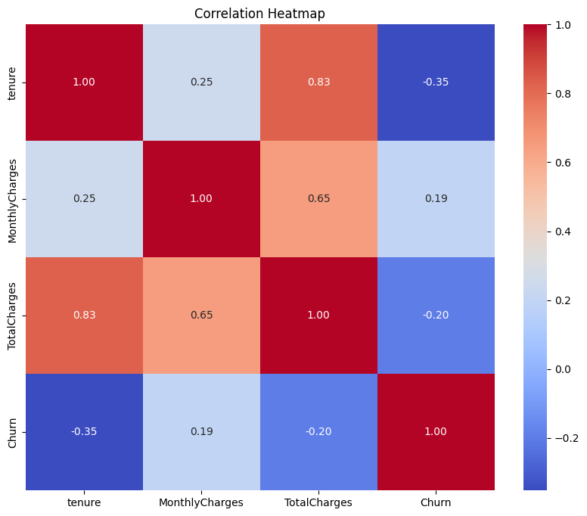
Correlation heatmap

Slide 9
Modeling Strategy
Models selected.
  Logistic regression. Selected as a baseline for its interpretability.
  Random forest classifier. Selected for its ability to handle complex, non-linear relationships and high accuracy.
Training process.
  Data split. 80% Training / 20% Testing.
  Features normalized to ensure fair weight distribution.

Slide 10
Model Evaluation & Results
Performance Metrics:
  Accuracy: ~80% (Random Forest performed best).
  Recall: Crucial for identifying churners. The model successfully captures a significant portion of at-risk customers.
Confusion Matrix Insight:
  Visualizes true positives (Churners correctly predicted) vs. false negatives (Churners missed).

Slide 11
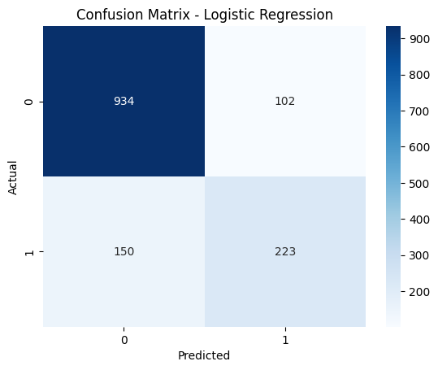
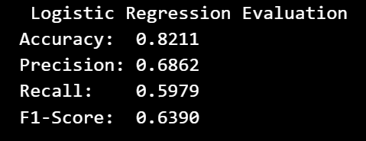
Confusion matrix (logistic regression)

Slide 12
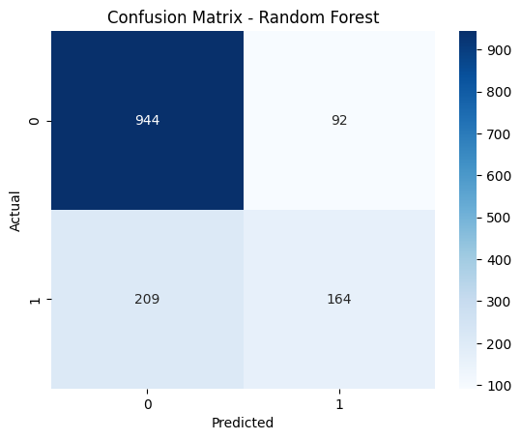
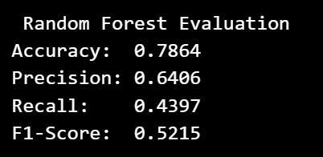
Confusion matrix (Random forest)

Slide 13
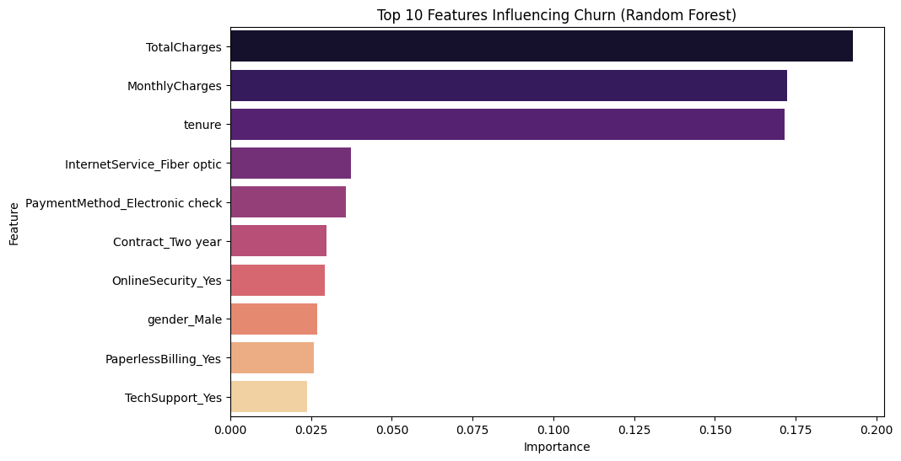
Feature Importance (Key Drivers)

Slide 14
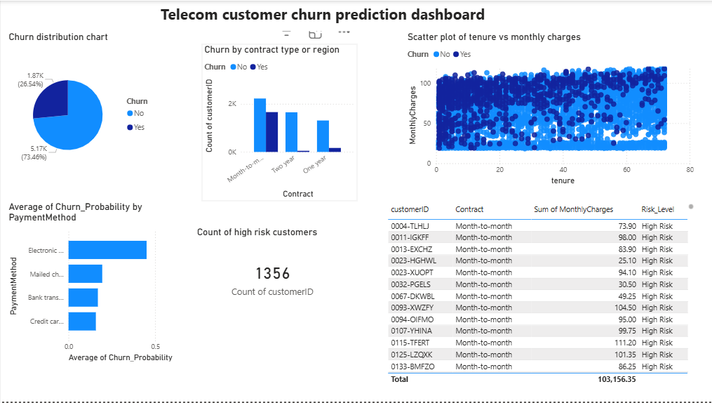
Dashboard (Power BI)

Slide 15
Recommendations and Conclusion
Strategic recommendations.
  Contract migration. Encourage month-to-month users to switch to 1-Year contracts (e.g., offer a discount).
  Payment method. Investigate user experience issues with "Electronic Check" or offer auto-pay discounts for credit cards.
  Targeted campaign. The marketing team should immediately contact the 1,356 High-Risk customers identified in the dashboard.
  Service quality. Review Fiber Optic infrastructure in East Africa, as these users churn frequently.

